Slide 1
Do Now
Height (cm) | Weight (kg)
163 | 57
168 | 64
173 | 68
183 | 79
For the following graph:
1

Slide 2
Do Now
Height (cm) | Weight (kg)
163 | 57
168 | 64
173 | 68
183 | 79
For the following graph:
1. “Height vs. Weight”
2. X-axis: “Height (cm)”
Y-axis: “Weight (kg)”
3. No – they should have used a scatter-plot. Both variables are numerical.

Slide 3
Tips to writing a good method:
Keep it clear and concise
Everything should be written in past tense
Make it step-by-step, in order of how you did it!
A method is a set of instructions that someone has followed, which is why it needs to be in the past tense.

Slide 4
Tips to writing a good method:
Keep it clear and concise
Everything should be written in past tense
Make it step-by-step, in order of how you did it!
A method is a set of instructions that someone has followed, which is why it needs to be in the past tense.

Slide 5
Observation
Using our senses
Inference
What we think is happening
Data
Information from the experiment
Aim
Why we’re doing an experiment
Method
What somebody did in an experiment

Slide 6
Variable
Any thing that can affect the experiment
Independent Variable
What we purposefully change
Dependent Variable
What is measured
Controlled Variable
What is kept the same
Hypothesis
What we expect to happen

Slide 7
Interpreting Graphs
Success Criteria
I can interpret a graph
I can define the terms “extrapolation” and “interpolation”
I can interpret trends in graphical data

Slide 8
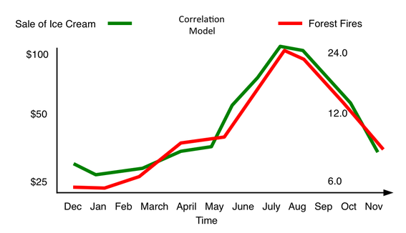
I can interpret a graph
Think – Pair – Share
What do you think the following graph is trying to tell us?
Think about your answer quietly
When instructed, share with a partner
When asked, share with the class.

Slide 9
I can interpret a graph
Time in Air (s) | Height (cm)
1 | 95
2 | 180
3 | 256
4 | 322
5 | 377
6 | 423
7 | 460
8 | 486
9 | 503
10 | 510
11 | 506
12 | 494
13 | 471
14 | 439
15 | 396
16 | 344
17 | 282
18 | 211
19 | 129
20 | 38
While graphs are normally easier to read than tables, that doesn’t mean they’re easy to read!
There are, however, some easy tricks we can use to interpret graphs – first, though, you need to figure out which kind of graph you have!

Slide 10
I can interpret a graph
Time in Air (s) | Height (cm)
1 | 95
2 | 180
3 | 256
4 | 322
5 | 377
6 | 423
7 | 460
8 | 486
9 | 503
10 | 510
11 | 506
12 | 494
13 | 471
14 | 439
15 | 396
16 | 344
17 | 282
18 | 211
19 | 129
20 | 38
To interpret a scatter-plot:
Start by writing what happens as the independent variable increases
Write what happens to the dependent variable – does it increase or decrease?

Slide 11
I can interpret a graph
Time in Air (s) | Height (cm)
1 | 95
2 | 180
3 | 256
4 | 322
5 | 377
6 | 423
7 | 460
8 | 486
9 | 503
10 | 510
11 | 506
12 | 494
13 | 471
14 | 439
15 | 396
16 | 344
17 | 282
18 | 211
19 | 129
20 | 38
For example:
As the time in air increases up to 10 seconds,
The height of the ball increases.
After 10 seconds in the air,
The height of the ball decreases.

Slide 12
I can interpret a graph
To interpret a column graph:
Identify the highest category
Identify the lowest category
Make sure to say how high each is
Fruit | Number of People
Apple | 25
Banana | 35
Orange | 15
Strawberry | 30
Mango | 20
Pineapple | 10
Watermelon | 12
Kiwi | 18
Grape | 22
Blueberry | 27

Slide 13
I can interpret a graph
For example:
The banana is the most favourite fruit,
The pineapple is the least favourite fruit.
35 people like bananas, but only 10 people like pineapples.
Fruit | Number of People
Apple | 25
Banana | 35
Orange | 15
Strawberry | 30
Mango | 20
Pineapple | 10
Watermelon | 12
Kiwi | 18
Grape | 22
Blueberry | 27

Slide 14
I can interpret a graph
Whenever we are interpreting a graph, there are two things we need to consider:
What was the aim of our experiment? Have we met it?
What was our hypothesis, and does the graph support this hypothesis?

Slide 15
I can interpret a graph
Time in Air (s) | Height (cm)
1 | 95
2 | 180
3 | 256
4 | 322
5 | 377
6 | 423
7 | 460
8 | 486
9 | 503
10 | 510
11 | 506
12 | 494
13 | 471
14 | 439
15 | 396
16 | 344
17 | 282
18 | 211
19 | 129
20 | 38
Aim: To determine if a tennis ball can break a window.
Hypothesis: If the tennis ball is thrown hard, it will break a window.

Slide 16
I can interpret a graph
Time in Air (s) | Height (cm)
1 | 95
2 | 180
3 | 256
4 | 322
5 | 377
6 | 423
7 | 460
8 | 486
9 | 503
10 | 510
11 | 506
12 | 494
13 | 471
14 | 439
15 | 396
16 | 344
17 | 282
18 | 211
19 | 129
20 | 38
Aim: No, this experiment has not met the aim. This data shows us what happens when a tennis ball is thrown in the air, nothing about what it hits.
Hypothesis: This data does not support the hypothesis. It has nothing to do with the hypothesis.

Slide 17
I can interpret a graph
Aim: To determine which fruit people like the most.
Hypothesis: Orange will have the highest fruit rating.
Fruit | Number of People
Apple | 25
Banana | 35
Orange | 15
Strawberry | 30
Mango | 20
Pineapple | 10
Watermelon | 12
Kiwi | 18
Grape | 22
Blueberry | 27

Slide 18
I can interpret a graph
Aim: Yes, we have learned which fruit people like the most – bananas.
Hypothesis: No, as bananas had the highest rating, not oranges.
Fruit | Number of People
Apple | 25
Banana | 35
Orange | 15
Strawberry | 30
Mango | 20
Pineapple | 10
Watermelon | 12
Kiwi | 18
Grape | 22
Blueberry | 27

Slide 19
I can interpret a graph
When we are interpreting a graph, we call this the discussion of our experiment. This also includes us identifying if the hypothesis was correct or not.
When we are checking to see if we answered the aim of our experiment, we call this the conclusion of our experiment.

Slide 20
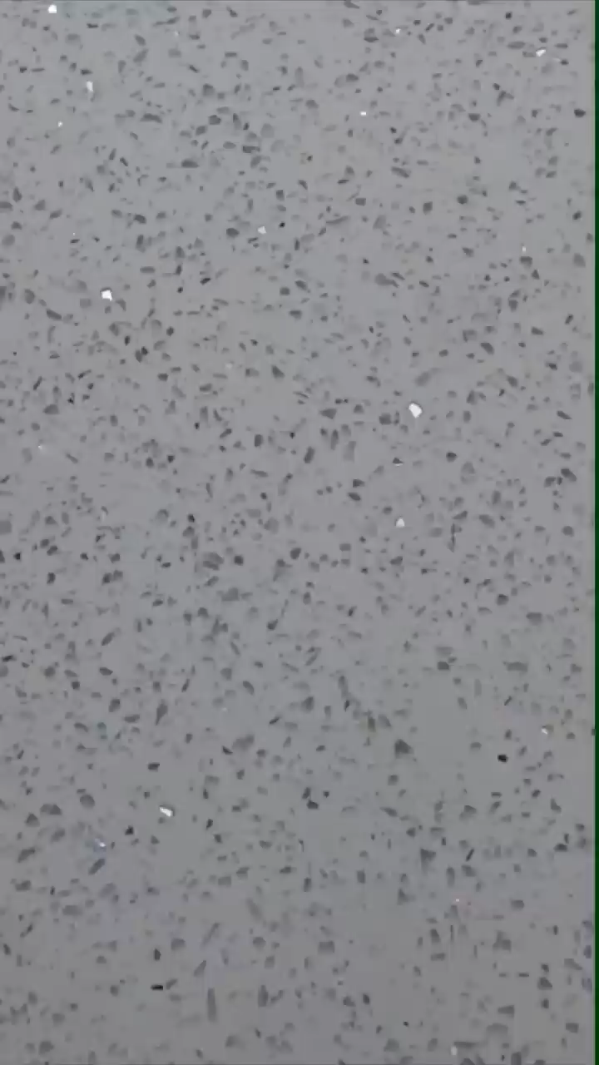
Brain Break
In this video, two of the facts shown are true, and the other is false. See if you can identify which is which before the end!
Notes:
https://www.youtube.com/shorts/jNJlny-nl0E if video doesn’t work

Slide 21
I can define the terms “extrapolation” and “interpolation”
There are two types of interpretations you can do with a graph:
Interpolation: this is when you make an interpretation inside your graph.
Extrapolation: this is when you make an interpretation outside your graph.
In general, interpolations are good, but extrapolations are bad and we want to avoid them.

Slide 22
I can define the terms “extrapolation” and “interpolation”
The following graph shows what happened to the height of a plant as it was given different amounts of water.
What does it tell us?
As you increase the amount of water given to a plant, it will grow more

Slide 23
I can define the terms “extrapolation” and “interpolation”
What might be an interpolation and an extrapolation of this data be?
An interpolation tells us that 250mL of water is a good amount to give to a plant.
An extrapolation might suggest that we should just give the plant as much water as possible.

Slide 24
I can define the terms “extrapolation” and “interpolation”
The experiment was done again, this time using larger amounts of water, and we actually found that the plant actually grows less if too much water is used!
As you can see, up to 300mL of water, the plant grows lots! After that, though, the plant doesn’t grow as much – it turns out that too much water can be bad for plants!

Slide 25
I can interpret trends in graphical data
Think – Pair – Share
If extrapolations are bad, why do we do them?
Think about your answer quietly
When instructed, share with a partner
When asked, share with the class.

Slide 26
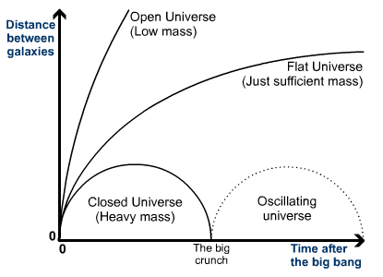
I can interpret trends in graphical data
Sometimes, we can’t get all the information. Or, we want to try and predict the future.
For example, scientists have 3 main predictions for what will happen to the universe. All 3 are based on the data we have collected so far, and you can see all 3 start from the same point as now!

Slide 27
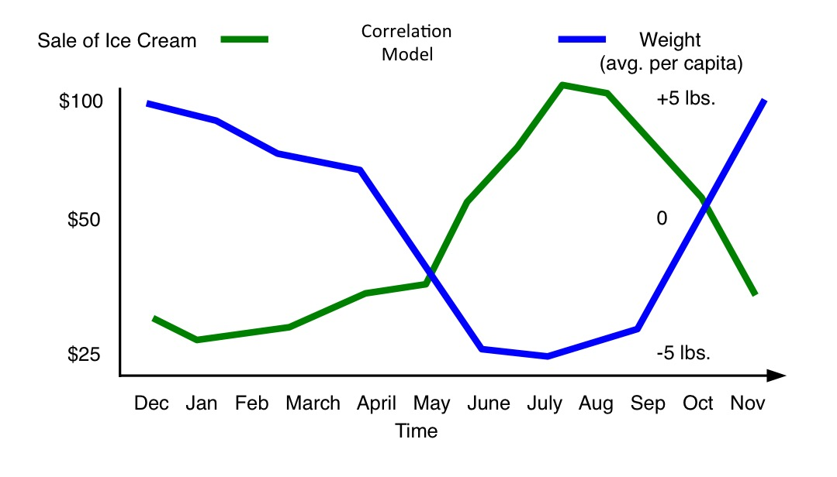
I can interpret trends in graphical data
Sometimes, we will find that one dataset increases at the same time as another – we call these correlations.
Sometimes, we can use these correlations. Other times, these correlations can be misleading.

Slide 28
I can interpret trends in graphical data
Sometimes, we can use these correlations to predict the future. Other times, these correlations can be misleading.
For example, do you really think that more forest fires are started just because more ice-cream is sold?

Slide 29
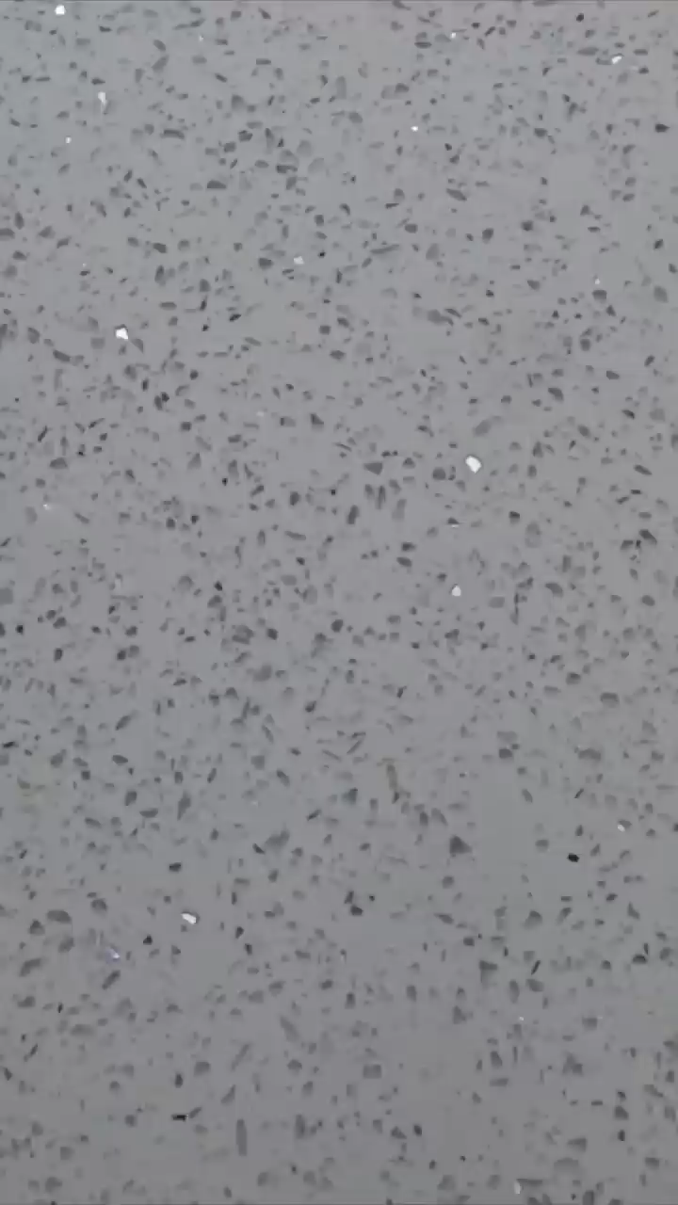
Brain Break
In this video, two of the facts shown are true, and the other is false. See if you can identify which is which before the end!
Notes:
https://www.youtube.com/shorts/iXn097j66sc if video doesn’t work

Slide 30
I can interpret trends in graphical data
For these graphs:
Interpret (interpolate) the graph
Predict (extrapolate) the graph

Slide 31
Interpreting Graphs
To interpret a graph, always start by saying what you did to the independent variable, then say what happened to the dependent variable.
If we interpret a graph only using the data there, it is an interpolation.
If we instead try to predict the future using a graph, it is an extrapolation.
Interpolations are better than extrapolations, but sometimes we have to use extrapolations.

Slide 32
Interpreting Graphs
We use science to try and predict the future all the time.
Common extrapolations you have experienced in your life include:
Trying to predict the weather
How much money you will spend on lunch
How long it will take you to get to school
Because we all use data in these ways, it is important we know how to interpret data.

Slide 33
Interpreting Graphs
Success Criteria
I can interpret a graph
I can define the terms “extrapolation” and “interpolation”
I can interpret trends in graphical data

